Slide 1
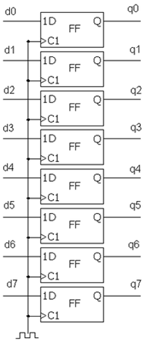
D
1Q
Shift
Register
2Q
3Q
רגיסטר 8 סיביות
Flip-Flop
יחידת חישוב
1D
Q
FF
ALU
C1
1D
Q
FF
MUX
C1
1D
Q
ENA
FF
C1
Counter
Compare

Slide 2
sel
Decoder
output
Decoder
input
Sel[0..0]
in
Out[1..0]
0
Din valid
Output_0
clk
Simple RAM
Data out
Data in
0
Output[1..0]
Addr in
input
Addr out
Dout valid
Output_1
Aout valid
RAM data
Simple RAM
Din valid
WE
clk
CLK
Data in
DATA OUT
Data out
DATA IN
1D
Q
Addr in
ENA
FF
WADDR
Addr out
C1
RADDR
Aout valid
dout valid
1D
Q
ENA
FF
C1

Slide 3
Addr in
sel
Decoder
output
Din valid
Reset
input
clk
Simple RAM
Data out
Data in
Addr in
Addr out
Dout valid
Data out
Clk
Aout valid
Data in RAM
Out valid
Din valid
clk
Simple RAM
Data out
Data in
Addr out
Addr in
Addr out
Dout valid
Aout valid
Din valid

Slide 4
Trigger
Configuration
‘0’
Trigger Type
Reset
Trigger Position
WBS_to_REG
Clk to start
System status
Trigger Type
Trigger Position
Clk to start
System status
Clk

Slide 5
Clk
System
status
Reset
System
status
wc to rc
2* Add
width_g
ALU
2* Add_width_g
rc_to_RAM
1D
Q
rc_to_RAM
FF
C1
RAM to rc
Signal_ram_width_g
Signal_ram_width_g
rc_to_WBM
rc_to_WBM
1D
Q
FF
C1

Slide 6
Trigger
‘0’
Trigger found
Reset
Trigger
Position
Aout valid
Trigger
Type
ALU
wc to rc
System
Status
Generics
next addr
ALU
First addr
Current addr
Addr in
1D
Q
FF
Data in WC
C1
Data in RAM
1D
Q
FF
Clk
C1

